Slide 1
Bioinformatics Recovering Evolutionary History
Assoc. Prof. Dr. Gazi Erkan BOSTANCI
Slides are mainly based on ‘Understanding Bioinformatics’ by Marketa Zvelebil and Jeremy O. Baum

Slide 2
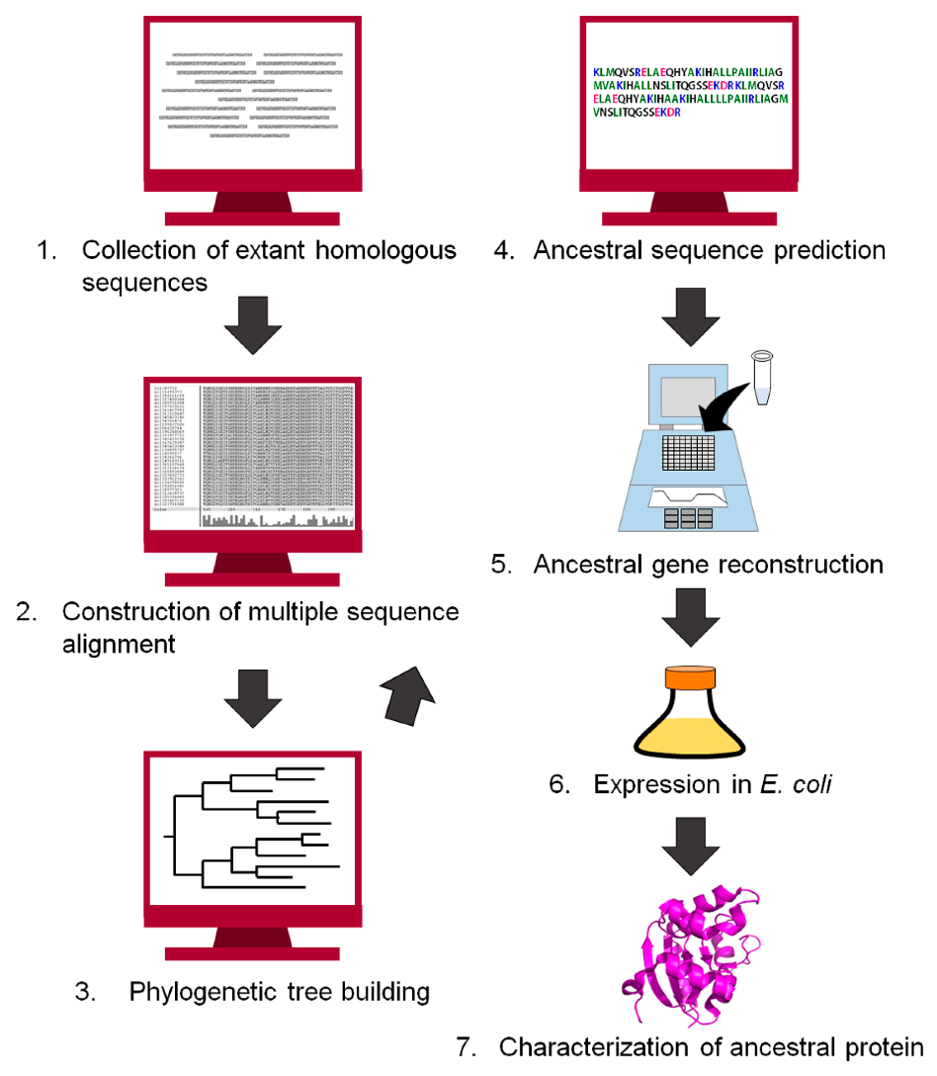
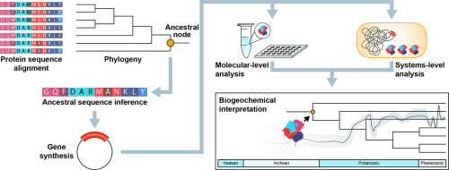
When a group of aligned sequences shows significant similarity to each other, this can usually be taken as evidence that they are the result of divergent evolution from a common ancestral sequence.
In this case, the sequence alignment will contain traces of the evolutionary history of these sequences. It is possible to infer this history by complex analysis of a multiple sequence alignment.
Ancestral protein reconstruction

Slide 3
This type of analysis can be applied to a number of distinct problems. By studying sequences that have both a common ancestor and common function—known as orthologous sequences or orthologs—from different species, one can investigate the evolutionary relationships between species.
These results can usefully be compared with an accepted taxonomic classification, which has probably been derived using different data.
In this lecture, we will consider the reconstruction of the evolutionary history of a set of sequences from a multiple alignment, and how this history can be represented as a graphical structure called a phylogenetic tree. We start by describing the types of trees and their features and how they can be interpreted.
The evolutionary history we hope to recover from the data will encompass many different types of mutational events, and we will discuss the relative evolutionary importance of different types of mutation in sequence change.

Slide 4
The Structure and Interpretation of Phylogenetic Trees
A phylogenetic tree is a diagram that proposes an hypothesis for the reconstructed evolutionary relationships between a set of objects—which provide the data from which the tree is constructed.
These objects are referred to as the taxa (singular taxon) or operational taxonomic units (OTUs) and in phylogenies based on sequence data they are the individual genes or proteins.

Slide 5
When orthologous sequences from different species are being used with the aim of determining relationships between species, the taxa are labeled with the species name.
Such trees are called species trees to distinguish them from those trees that are intended to show the relationships between the genes or proteins in a large gene family.
Species trees can also be constructed from data other than sequences, such as the morphological features used in traditional taxonomy, the presence of certain restriction sites in the DNA, or the order of a particular set of genes in the genome.

Slide 6
The basic features of phylogenetic trees are illustrated in the figure below, using imaginary bird species as the objects or taxa. The species are connected via a set of lines, called branches or edges, which represent the evolutionary relationships between them.
Those species that occur at the external nodes or leaves of the tree are either existing species that have not as yet evolved into new species, or else are extinct species whose lineage died out without leaving any descendants.
To be precise, we should say that the dataset used to produce the tree lacks such descendant species, as it is quite possible for the dataset not to contain data from all related species. The branches do not join any of the external nodes together directly, but via internal nodes, which represent ancestral states that are hypothesized to have occurred during evolution.

Slide 7
In our bird species tree, for example, the internal branch points represent speciation events that produced two descendant divergent species.
Likewise, when sequence data have been used to build a species tree, with each species represented by one sequence, the internal nodes represent the ancestral sequences from which the present-day sequences have diverged after speciation.
Unrooted and rooted phylogenetic trees. These trees reconstruct the evolutionary history of a set of six imaginary extant bird species, which are shown at the outermost tips of the branches—the external nodes or leaves. These are the species from which the data to construct the tree have been taken.
These data could be morphological data or sequence data. The birds shown at the internal nodes are the predicted (reconstructed) extinct ancestor species.

Slide 8
(A) A fully resolved unrooted tree.
This tree is fully resolved in that each internal node has three branches leading from it, one connecting to the ancestor and two to descendants.
However, the direction of evolution along the internal branches—that is, which ancestral species has evolved from which—remains undetermined.
Thus we cannot distinguish from this tree alone whether the yellow birds evolved from a brown bird, or vice versa.

Slide 9
(B) A fully resolved rooted tree for the same set of existing species.
The brown bird marked “root” can now be distinguished as the last common ancestor of all the yellow and brown birds.
The line upward from the root bird indicates where the ancestors of the root bird would be. In a rooted tree, there is a clear timeline (shown as a gray arrow) from the root to the leaves, and it is clear which species has evolved from which. Thus, the yellow birds did evolve from a brown bird.
Apart from the region around the root in (B), the two trees are identical in the relationship between the taxa and give the same information.
The arrangement of the branches in space is different, but the information in a phylogenetic tree is contained solely in the branch connections and branch lengths.

Slide 10
Under normal evolution, a given taxon will have evolved from a single recent ancestor and if it does not become extinct first, may diverge into two separate descendant taxa. As a consequence, any internal node of a phylogenetic tree is expected to have three branches; one to an ancestor and the other two to descendants.
This branching pattern is called bifurcating or dichotomous. The external nodes, which have not yet produced descendants, have a single connection to their ancestral taxon. There are very rare evolutionary events that do not obey this rule.

Slide 11

Two species can merge into one, as is thought to have occurred when eukaryotic cell ancestors entered into symbiosis with the prokaryotes that eventually became mitochondria and chloroplasts

Slide 12
Alternatively, a single population might simultaneously give rise to three or more distinct new species. If all the internal nodes have three branches the tree is said to be fully resolved, meaning that it hypothesizes a location for all the expected speciation or gene duplication events.
A partially resolved tree will have at least one internal node with four or more branches, sometimes described as multifurcating or polytomous.

Slide 13
Trees can be either unrooted or rooted:
Rooted trees represent the divergence of a group of related species from their last common ancestor, the root, by successive branching events over time.
Unrooted trees, on the other hand, show the evolutionary relationship between taxa but do not identify the last common ancestor.
In a rooted tree the direction of evolution along each of the branches is unambiguous. In an unrooted tree, by contrast, which ancestral species evolved from which is not clear once one gets to the internal branches.
There are two further components to the description of a phylogenetic tree—the tree topology or the way it branches, and the branch lengths. In some types of tree there are no defined branch lengths, and in general it is the topology that is the main interest. Even for a small number of sequences there are many possible trees with different topologies.

Slide 14
(A) A cladogram in which branch lengths have no meaning.
(B) An additive tree, in which branch lengths are a measure of evolutionary divergence. The branch lengths here are given in arbitrary units proportional to the number of mutations per site, from which we can see that the evolutionary distance between the two yellow birds (3 + 6 = 9) is three times that between the two brown birds (1 + 2 = 3).
(C) An ultrametric tree, which in addition to the properties of the additive tree has the same constant rate of mutation assumed along all branches. The scale on the right of the tree is proportional to time as well as to the number of mutations per site.
(D) An additive tree for the same set of species, which has been rooted by the addition of data for a distantly related outgroup (orange bird). Note that in this tree the external nodes are at different distances from the root.

Slide 15
Apart from the presence or absence of a root, there are three basic types of tree representation. A rooted cladogram shows us the genealogy of the taxa but says nothing about the timing or extent of their divergence.
In this type of tree the branch lengths have no meaning, and only the tree topology is defined. The cladogram simply tells us that the four taxa—the four birds—have a common ancestor that initially evolved into two descendants, one the common ancestor of the yellow birds and the other the common ancestor of the brown birds. Although the tree has been drawn with different branch lengths, so that the brown birds appear to have diverged more recently than the yellow birds, it is important to note that this is only for artistic effect, and the branch lengths have no scientific basis.
The ancestors are not shown on the tree, only the branches. This is the normal way of presenting trees, with the ancestors only implied by the internal nodes. Most tree-reconstruction methods do not explicitly predict any properties for the ancestral states, and thus would have no useful representation to put at internal nodes. It is also easier to see the connectivity in this form of tree representation. Because the techniques used to reconstruct trees using sequences almost always give more quantitative information, cladograms are rarely used in sequence analysis.

Slide 16
In an additive tree, branch lengths represent a quantitative measure of evolution, such as being proportional to the number of mutations that have occurred. The tree shown here is rooted, but unrooted additive trees can also be made. The evolutionary distance between any two taxa is given by the sum of the lengths of the branches connecting them.
This tree contains all the information given by the cladogram, but also tells us that the common ancestor of the yellow birds is a smaller evolutionary distance (3) from the root than is the common ancestor of the brown birds (4).

Slide 17
An ultrametric tree, which in addition to the properties of the additive tree, has the same constant rate of mutation assumed along all branches.
This last property is often referred to as a molecular clock, because one can, in principle, measure the actual times of evolutionary events from such trees.
All ultrametric trees have a root, and one axis of the tree is directly proportional to time. In our depiction this is the vertical axis, with the present day at the bottom and the last common ancestor at the top.
The horizontal lines have no meaning, and are simply used to display the tree in a visually pleasing way. Note that the evolutionary distance from a common ancestor to all its descendants is the same, a condition not usually observed in an additive tree.

Slide 18
Sequence data often do not conform to a molecular clock, however. Non-clock-like sequence evolution probably results from a variety of causes, including changes in mutation rate as a result of changes in evolutionary pressure and increasing constraints on change in an organism’s morphological structure and metabolism.
If an ultrametric tree is used to represent such data it can lead to an incorrect tree topology as well as incorrect branch lengths. In such cases an additive tree will be more accurate. Unlike ultrametric trees, which are always rooted, additive trees often lack a root.

Slide 19
When a rooted tree is required, the most accurate method of placing the root is to include a group of homologous sequences from species or genes that are only distantly related to the main set of species or genes under study. This is known as the outgroup, while the group of more closely related species are known as the ingroup.
Figure (D) shows an additive tree constructed using the same species as Figure (C) with the addition of the orange bird as an outgroup. The root can then be located between the outgroup and the remainder of the taxa.

Slide 20
Tree topology can be described in several ways
Some tree-construction methods can produce several alternative trees that seem equally good at representing the data.
Another occasion when alternative trees can arise is when different methods, models, or parameters are used to analyze the same data.
Finally, there are occasions when it is interesting to compare the reconstructed evolutionary history produced by two or more sets of data, such as different genes from the same set of species.
We therefore need ways of describing tree topology in a form that makes it possible to compare the topologies of different trees.

Slide 21
The graphical views of trees are convenient for human visual interpretation, but not for other tasks such as comparison. One way of summarizing basic information about a tree in computer-readable format is to subdivide or split it into a collection of subgroups.
Every branch in a tree connects two nodes, and if that branch is removed, the tree is divided into two parts. Such a division is called a split or partition, and a tree contains as many splits as there are branches. Note that since every split contains two groups, which together make up the entire tree, only one group need be given to define the other.
The set of splits formed by removing an external branch are inherently uninteresting because every possible tree for the same set of taxa will produce this set. Splits involving internal branches are more interesting as they can confirm a common origin of a set of taxa.

Slide 22
For the figure below (A) shows a tree connecting eight mammalian taxa. By removing the branch with the label X, it can be seen that the sea lion and seal form a group of their own, distinct from the other animals.
Figure(B) shows the set of internal branch splits for this tree. A fully resolved unrooted tree with N taxa has N – 3 splits; the equivalent number in the case of a rooted tree is N – 2.

Slide 23
A tree can be represented as a set of splits.
(A) An unrooted additive tree using fictitious data for eight mammalian taxa. The horizontal lines carry the information about evolutionary change; the vertical lines are purely for visual clarity. This common depiction of an unrooted tree is drawn as if the tree were rooted at the midpoint of the distance between the most widely separated taxa; that is, the two taxa connected by the longest total line length.
Note that because the tree is unrooted, the branch connecting the monkey to the rest of the tree is not an internal branch. Thus, the evolutionary distance from the monkey to its nearest internal node is represented by the sum of the lengths of the two horizontal lines connected by the leftmost vertical line in the figure. The scale bar refers to branch length and in this case represents a genetic distance of 0.2 mutations per site.
(B) A table representing all the possible internal branch splits of the tree shown in (A). The columns correspond to the taxa and the rows to the split. The two groups of each split are shown by labeling the taxa in one group with an asterisk, and leaving the others blank. As every split contains two groups that together make up the entire tree, only one group need be given to define the other.

Slide 24
When splits are calculated for a rooted tree, one of the two groups of taxa will always be monophyletic; that is, the group will contain all the descendant taxa from the ancestor represented by the internal node at the end of the cut branch more distant from the root.
On occasions, it has been found that some of the groups of organisms traditionally classified together are not monophyletic, suggesting that the classification scheme needs revision.

